Slide 1
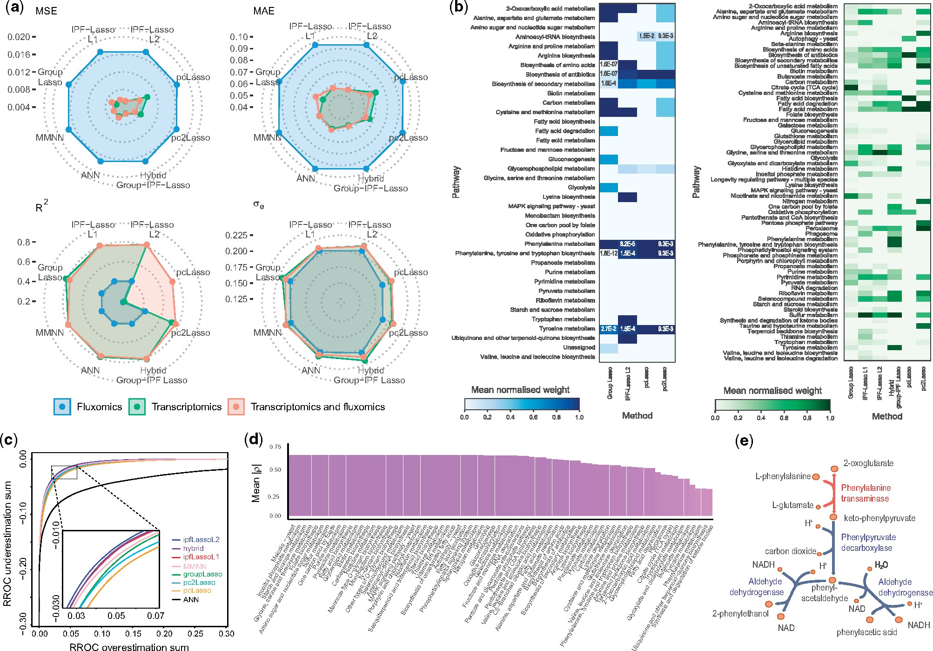

Fig. 2. (a) Comparison of RLMs and MMNN across evaluation metrics and learning settings. The bigger the polygon drawn ...
Notes:
Fig. 2. (a) Comparison of RLMs and MMNN across evaluation metrics and learning settings. The bigger the polygon drawn by the learning setting, the worse the results for MSE, MAE and σe and the better for R2. The fluxomics data alone does not perform well for all the metrics (except for σe). On the other hand, for some methods, combined learning with both transcriptomics and fluxomics data leads to better performance. (b) Average weight attributed to each of the related pathways according to the associated metabolic fluxes (left) and genes (right) for the RLMs. For better visualization, we reported even the nonstatistically significant pathways, and scaled the weights for each method separately. The statistically significant pathways are indicated by P-values (only for the metabolic fluxes). (c) RROC curves for the tested methods in the integration setting. Our IPF-Lasso and Group-IPF-Lasso showed higher robustness than the other algorithms. (d) Mean Pearson correlation along the pathways in the fluxomics dataset. The coefficients were computed by calculating the absolute values of the Pearson correlation between each metabolic flux and the growth rate, and then averaging them within each pathway. (e) Ehrlich pathway for the catabolism of phenylalanine. The reaction in red is amongst the ones selected by IPF-Lasso with L2-norm as a penalty. The main metabolites are represented by bigger circles
Unless provided in the caption above, the following copyright applies to the content of this slide: © The Author(s) 2021. Published by Oxford University Press. All rights reserved. For permissions, please e-mail: journals.permissions@oup.comThis article is published and distributed under the terms of the Oxford University Press, Standard Journals Publication Model (https://academic.oup.com/journals/pages/open_access/funder_policies/chorus/standard_publication_model)

